Slide 1

1
2
0
4
5
3

Slide 2
Enjoy The Presentation

Slide 3




Information & Communication Technology
Realised by Group 22
ICT
03/01/2024
USTHB

Slide 4
1
4
Impact
Introduction
Components
2
5
Tools
Plan
3
6
Role In Society
Conclusion

Slide 5

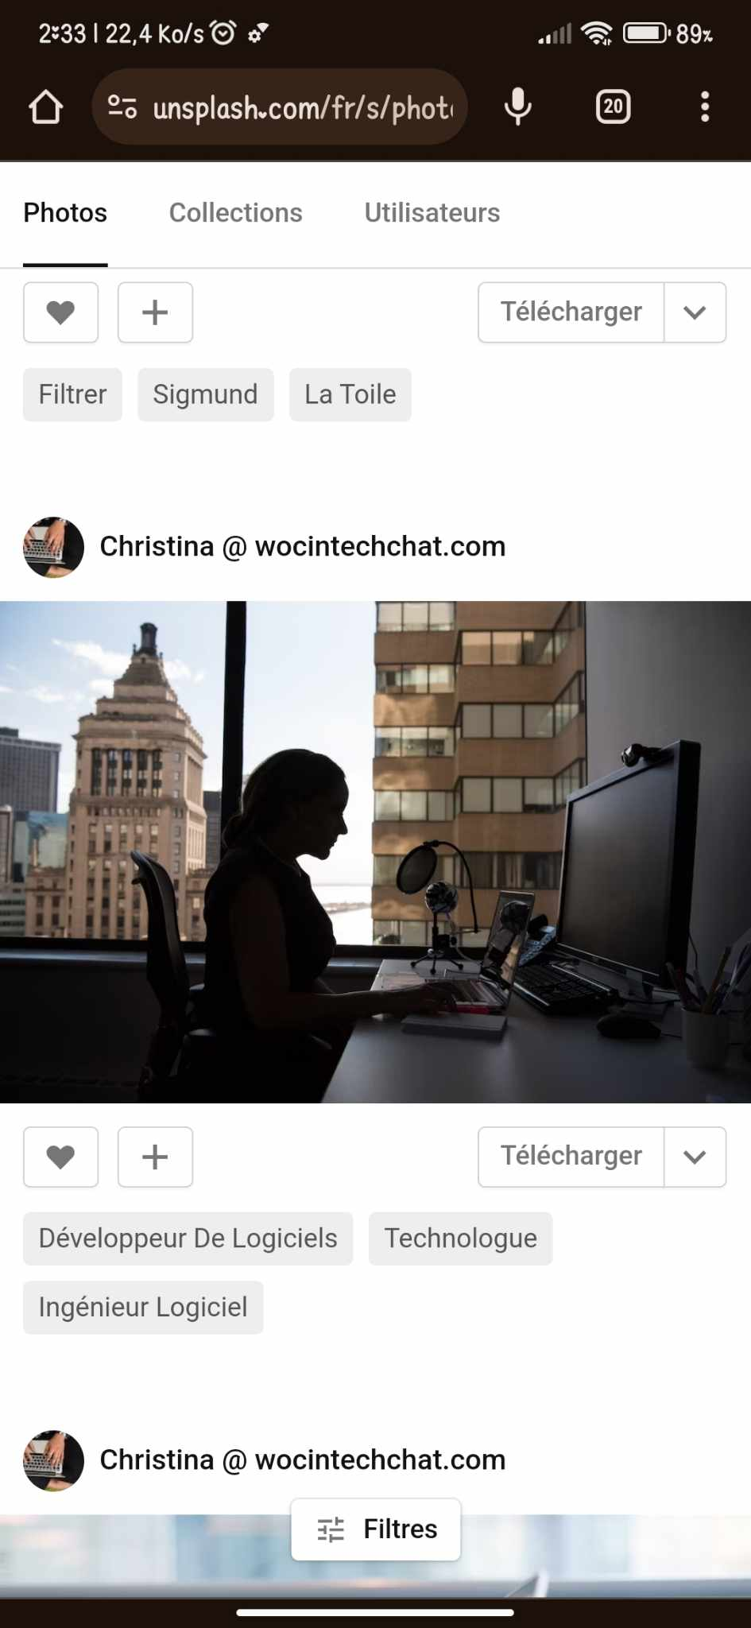
INTRODUCTION:
Understanding ICT doesn't require mastering every technical detail. But by appreciating its broad reach and potential, we can become more informed users, responsible citizens, and active participants in shaping a future where technology serves humanity for the greater good.
So, whether you're a tech enthusiast or a curious newcomer, welcome to the fascinating world of ICT ! It's a journey worth exploring, with limitless possibilities waiting to be discovered.
Group 22

Slide 6


What is ICT ?
Information and communication technologies (ICT) is an umbrella term that encompasses all the technologies used for the acquisition, processing, storage, and transmission of information.
.
This is the broadest definition, encompassing all the technologies used for the acquisition, processing, storage, and transmission of information. This includes everything from computers and mobile devices to networks, software, and the internet itself.

Slide 7


Negative Impacts:
Positive Impacts:
Digital Divide,
Addiction and Mental Health,
Cybersecurity Threats,
Global Collaboration
Job Displacement,
Engaging Learning Experiences
Ethical Considerations
Personalized Learning
Remember, ICT is just a tool. How we use it is what truly matters. Let's strive to harness the power of ICT for positive change and create a better world for all.
Democratization of Knowledge
Empowering Communities

Slide 9


ICT is a powerful tool that has the potential to improve our lives in many ways. However, it's important to use ICT responsibly and address the challenges it presents to ensure that everyone benefits from its full potential

Slide 10




Conclusion:
ICT has profoundly transformed our world, offering immense potential for progress and development. However, we must navigate its challenges responsibly, ensuring equitable access, addressing ethical concerns, and mitigating potential harms. The future of I ICT lies in harnessing its power for good, while safeguarding against its downsides.

Slide 11


Thank you for your attention

